Slide 1
Life Insurance Leveraging
Jeff Caligiuri, cfp, clu, tep, chs
Onyx financial Group
March 4, 2019 for the estate planning council of winnipeg

Slide 2
Agenda
Creativity and flexibility of insurance (UL & PAR whole life)
Traditional use vs accumulation/leverage
Two most common leverage strategies (front end vs back end)
Personal vs corporate leveraging
CRA interpretation and concerns
Questions/discussion

Slide 3
Insurance as an accumulation tool
Outside of traditional use of life insurance for “pure risk” protection ie income replacement, debt protection, estate taxes etc.
Usually designed for clients that have excess wealth, excess cash flow, or those looking for a diversification strategy that is tax efficient and potentially low risk that can compliment other assets.
Accumulation of assets within the plan grow tax deferred and are either passed on to beneficiary/estate/heirs or can be accessed via policy loan, cash withdrawal, surrender or collateral loan. (important to consider taxation of each option depending on the overall need)
Can help those with corporate assets/cash flow, shelter from newly introduced passive income rules
Perhaps needs have changed over the years…what was once used for protection now creates other opportunities (ie income supplement, investment opportunities, business development etc)

Slide 4
Two most common strategies
1) Back End Leveraging/Collateral Loan
Accessing the funds of a UL or Par policy that have accumulated over the years
Typically 90% loan ratio for Par and 50-90% for UL depending on asset mix/holdings
Usually facilitated by Schedule 1 bank by line of credit and subject to banks lending criteria and process
Funds can be accessed via lump sum or monthly/annual advance
Interest is usually capitalized and offsetting loan is repaid upon death
Requires collateral assignment of the life insurance policy
If funds are being used for re-investment purpose, then possible interest deductibility can apply

Slide 5
Back end leverage/collateral loan

Slide 6
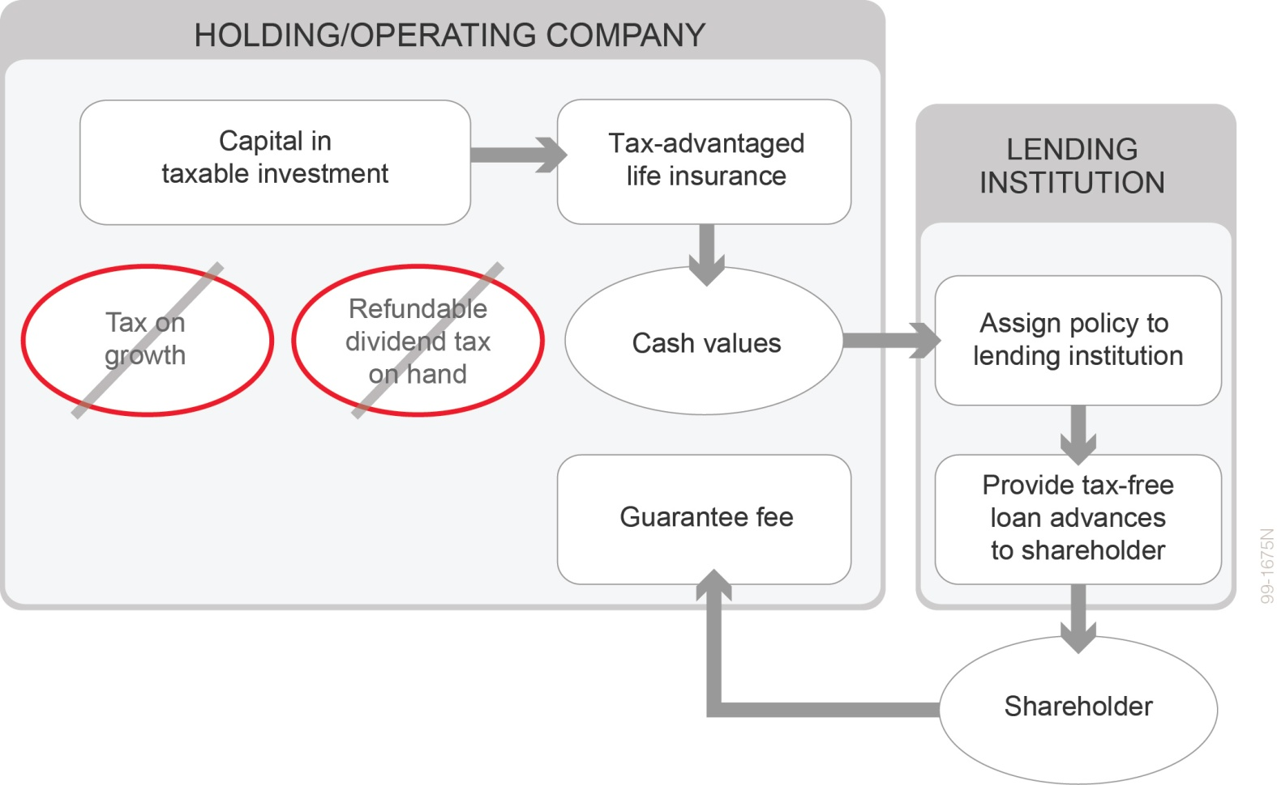
Personal borrowing on corporate policy
Notes:
For aggressive investors, personal borrowing using the corporate policy as collateral may be of interest to otherwise avoid paying tax on dividends from the corporation. There are implications to be considered.
There could be a taxable shareholder benefit (not deductible to the corporation) if the shareholder does not pay the corporation a guarantee fee. A reasonable guarantee fee may be 1 – 2 per cent of the loan balance.
Upon death of the insured, the direct payment to the lender to repay the personal loan may be considered a taxable shareholder benefit (and not deductible to the corporation). Careful planning needs to take place with the lender to ensure the corporation effectively receives the death benefit, in order to avoid the shareholder benefit and ensure the credit to the corporation’s capital dividend account occurs. Have clients talk with a tax advisor.
Should the lender demand repayment of the loan while the insured person is living, the life insurance policy could possibly be forced to be surrendered. Tax could be triggered upon the surrender, with no remaining funds from the policy to pay the tax.

Slide 7
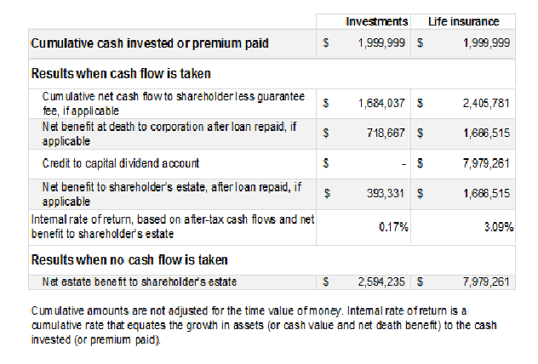
Back end/Collateral Loan cont’d
Notes:
Assumptions for illustrative purposes:
Male 50 non smoker, GWL Enhanced Legacy PUA
$100,000 annual premium for 20 years vs $100, 000 annual deposit into interest bearing investment at 4%
Loan assumption 6% & 90% loan to cash value ratio at age 90
Personal borrowing with Guarantee fee of 1% back to corporation
Start income at age 71 for 20 years
Using Life insurance strategy with accessing:
Deposit $2,000,000 over 20 years
Income of approx. $2.4million from 71-90
Net death benefit at age 90 = $1.66million after loan repaid
CDA (credit to Capital Dividend Account) of $7.9million

Slide 8
CRA interpretations & concerns
-Back to Back loan rules - subsection 15(2.16) to (2.192) of the Act
- deemed possible income inclusion Subsection 15(2) of the Act
- Specified Right 18(5) of the Act
- Guarantee Fees
- Loan repayment at death

Slide 9
Most common cont’d
2) IFA or Immediate Financing Arrangement (Front End Leveraging)

Slide 10
Immediate financing arrangement (IFA)
A strategy for:
A business owner or investor to keep funds used for the business or investment
Drastically minimizing cash outlays for insurance costs in the short term
Reducing cash outlays for insurance costs over the long term

Slide 11
What’s an IFA?
Business diverts cash flow or repositions investment dollars into a policy over a number of years
Business gets a bank loan to replace the dollars that went into insurance:
The policy, and potentially other assets, are assigned to the bank as collateral
Business pays the loan interest going forward
Business gets two tax deductions: interest and collateral life insurance (NCPI) – if structured properly
Death benefit pays off loan; what’s left over serves the business owner’s insurance needs

Slide 12
What’s an IFA?
During life – Setting it up
Bank
Purchase policy
Collaterally assign policy + additional collateral
Holdco
Loan advances = premium
Loan advances used to (re)purchase investments or (re)invest in business

Slide 13
What’s an IFA?
During life – How it operates
Bank
Holdco
Holdco pays bank loan interest annually
Reduced tax from:
Interest deduction
Collateral life insurance deduction
CRA

Slide 14
What’s an IFA?
On death
Estate
Estate
Named beneficiary:
SPOUSE
HEIRS
CRA
CHARITY
Client dies
Net death benefit
Net death benefit distributed as capital dividend (CDA required)
Bank
Holdco
Holdco
Policy pays off loan, net death benefit received by policy beneficiary

Slide 15
Immediate Financing Arrangement
What was accomplished?
Client acquires permanent life insurance protection
Death benefit available to beneficiary equals insurance proceeds minus loan balance
Client’s capital is largely intact
The cash used to purchase the life insurance policy is replaced with the borrowed money

Slide 16
Immediate Financing Arrangement
What was accomplished? (cont.)
3. Cost of insurance is reduced
Out of pocket cost of the life insurance is effectively the loan interest less the tax savings from the loan interest and collateral insurance deduction
Works better with higher tax rates
Interest may be “capitalized”
Capital dividend account (CDA) credit, if a corporate IFA
CDA available to enable tax-free distribution of other assets, credit generally equals total death benefit less the policy’s adjusted cost basis (ACB)

Slide 17
IFA vs no IFA
Notes:
Male 50 non smoker
GWL Enhanced Wealth PUA
$100,000/year for 20 years
Service the interest annually
5.5% lending rate
Policy held in HOLDCO at top corp tax rate in MB at 50.67%
Borrow back 100% of the premium paid

Slide 18
Immediate Financing Arrangement
Client profile
This strategy is not for everyone!
Client needs life insurance but:
has cash flow concerns (asset rich and cash poor); or,
concerned about opportunity cost of premiums
Affluent and financially stable
A business owner or investor that is Risk tolerant
Comfortable with a reasonable amount of debt
Many tax, banking and financial considerations

Slide 19
Immediate Financing Arrangement
Tax rules
Interest deductibility (paragraph 20(1)(c)):
Purpose test – loan used for the purposes of earning income from a business or property
Paid or payable
Legal obligation
Limited to a reasonable amount

Slide 20
Immediate Financing Arrangement
Tax rules
Collateral life insurance deduction (paragraph 20(1)(e.2)):
Assignment of policy required by lender
Lender is a “restricted financial institution”
Interest on loan is deductible
Lesser of “premiums payable” and “net cost of pure insurance” (NCPI)
The lesser amount must “reasonably be considered to relate” to the amount owning
Prorate to amount owing as percent of death benefit

Slide 21
Immediate Financing Arrangement
Bank lending considerations
Collateral loans involve risk. They should only be considered by sophisticated investors with high risk tolerance and access to professional advice from a lawyer and accountant. The terms of future availability of collateral loans cannot be guaranteed.
The loan or line of credit must be negotiated between the policyowner and the lender. It is subject to the lender’s financial underwriting and other requirements.
The policyowner should have enough income and capital to cover the interest and loan repayment, as well as the insurance premium.

Slide 22
Immediate Financing Arrangement
Bank lending considerations (cont.)
Not all banks have IFA loan programs
Minimum lending prerequisites of $30,000 per annum for 10 years
Client must apply and qualify for financing annually
Loan / CSV ratio up to 100% (depends on lender and type of policy and investment options chosen if UL)
Additional collateral required if shortfall between loan and loan / CSV ratio
Loan typically has no preset amortization and no scheduled principal payments, interest paid regularly and typically charged at a floating rate
Interest capitalized on a “case by case” basis
Most banks charge setup fees, potential legal costs

Slide 23
Immediate Financing Arrangement
Financial and other tax considerations
Interest rates may fluctuate
Performance of the life insurance policy
Change in bank lending terms / conditions
Other assets at risk
Availability of taxable income to use tax deductions
Availability of tax deductions
Changes in tax laws (legislation and case law) and CRA interpretations

Slide 24
Final Thoughts
- proper planning required as these strategies involve extra risk, important to weigh pros/cons to make sure it’s a fit
-consult with clients other team of advisors where necessary ie accountants, lawyers, bankers
- get lenders involved early on in the process
- be sure to address any fees, costs, timelines, financial underwriting and credit needs, and most importantly any tax consequences
- beware of gimmicky and too good to be true strategies….due diligence is key
- for those that are not insurance professionals, it’s important to be aware that these strategies exist and not all are deemed to be gimmicky….some leveraging strategies can be excellent planning tools for the right client…..working together for the best interest of the client is a win win for everyone involved

Slide 25
Thank you
Jeff Caligiuri CFP, CLU, TEP, CHS
ONYX Financial Group
204-777-6699
jeff@onyxfinancial.ca

